Slide 1

Image cryptography using Elliptic curve and Magic matrix with Advanced encryption standard
GROUP MEMBERS:
DERIL RAJU (BE/10489/16)
MUPPIDI SAI PRANAV (BE/10488/16)
LALITHA ELESWARAPU (BE/10435/16)
Guide
Dr. Rupesh Kumar Sinha

Slide 2
Contents
Motivation
Introduction
Objective
Literature Review
Methodology
Results and discussions
Future Works
References

Slide 3
Motivation
Most of the modern data is transferred via internet, if no proper encryption standards are used, they can be easily accessed by people who are not meant to receive it.
Many sectors like banks, IT companies and social media have the risk of disclosure of sensitive information.
Thus, there is need to develop an image encryption standard which can withstand robust hacking techniques without compromising the speed and reliability of the system.

Slide 4
Introduction
Image Cryptography is a widely used technique which has found great application in the fields of military and intelligence, social networking and financial services.
The main motto of cryptography is to service the growing need for increased security of information in various fields.
Objective
To design an efficient encryption/decryption scheme using Elliptic curve cryptography and Magic matrix scrambling technique with the help of AES encryption.

Slide 5
Literature Review
Padma Bh et al (2010) have presented a model to encode and decode messages using Koblitz’s Method in Elliptic Curve Cryptography.
Ali Soleymani et al (2013) have proposed a cryptosystem for image encryption/decryption using a novel mapping scheme involving elliptic curves.
K Mani & M Viswambari et al (2017) explained generation of key matrix for cipher using magic rectangle. Magic matrix can’t encrypt the image properly if the image is gray or if image consist of large area of same color. This drawback of magic matrix can be removed by using a proper key matrix. They proposed a deterministic method for generation of key matrix of higher order k from magic rectangle.
Pachamuthu Rajalakshmi et al (2010) have presented a compact hardware-software co-design of Advanced Encryption Standard (AES) on the field programmable gate arrays (FPGA) designed for low-cost embedded systems.

Slide 6
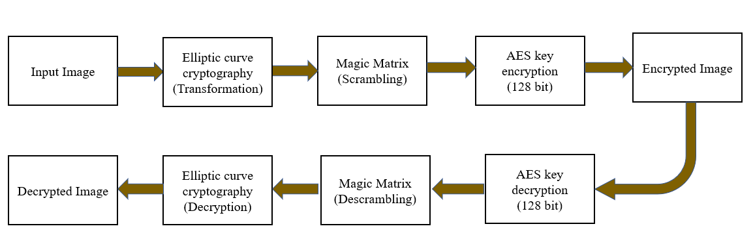
Proposed Block Diagram

Slide 7
Introduction to Elliptic curves
An elliptic curve is a plane curve defined by an equation of the form
y² mod p=(x³+ax+ b) mod p
a, b and p are known as elliptic curve parameters; ‘a’ and ‘b’ decide the shape of the curve, while ‘p’ decides the range.
In this model, the value of curve parameters used are:
a = -1, b = 188, p = 3049 .
In our model, ECC has been used to transform pixel intensity values.
With respect to the curve, ‘x’ refers to the original intensity value while ‘y’ refers to the transformed value.

Slide 8
Encryption of pixel intensity values
Step1: An elliptic curve Ep(a,b) was chosen.
Step 2: Based on the value of p, range of the curve was determined
Step 3: An image was inputted and read as a matrix of pixel intensity values. These values range from 0(black) to 255(white).
Step 4: An auxiliary base parameter(k), for example k = 20, was chosen.
Step 5: An attempt was made to the solve the elliptic curve for x=mk+1 (for every mk), where m represents an individual pixel intensity value.
Step 6: If the curve could not be solved using x=mk+1, x=mk+2,3,4….(k-1) were given as inputs to the elliptic curve equation.
Step 7: A value of y was reached before reaching x = mk + k-1. Thus a point (x,y) was now obtained on the elliptic curve, which represented a value in the input matrix.
Step 8: The entire input image matrix was converted into a matrix of new points which represented solutions of the elliptical curve.

Slide 9
Modifications
Encryption of pixels was done by drawing parallels from Koblitz’s method of encoding text messages.
The values of ‘Y’ for respective ‘X’ on the elliptic curve can range from 0 to ‘p’.
Since pixel intensity values only ranged from 0 to 255; and diminishing the value of ‘p’ or base parameter ‘k’ could either lead to decreasing the range of operation or decreasing the probability of solving the curve with a particular value of x, the modulo operator (mod 255) was used for all the outputs obtained by solving the curve.
The values of quotient were stored in a separate array; they can later be used to reconstruct the ‘Y’ value, which can lead to the pixel intensity value of the original image, during decryption.

Slide 10
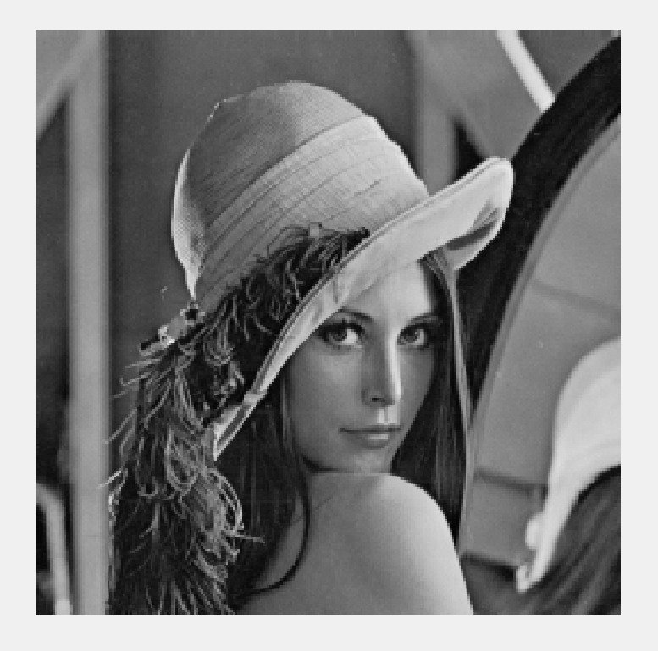
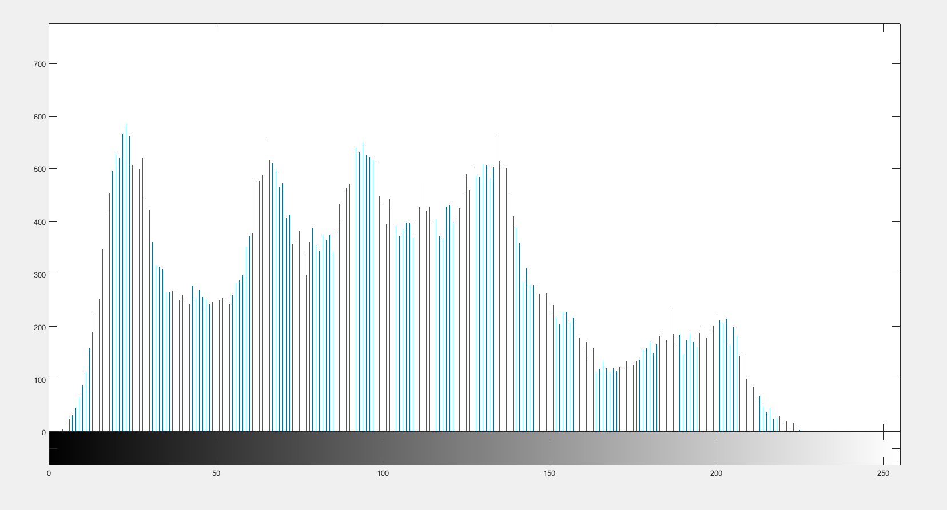
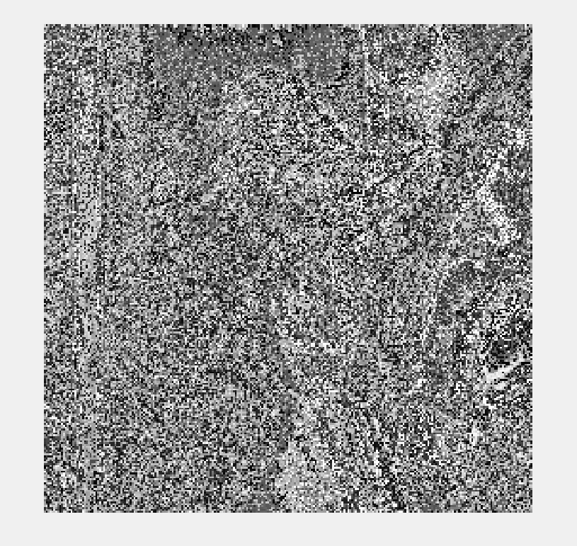
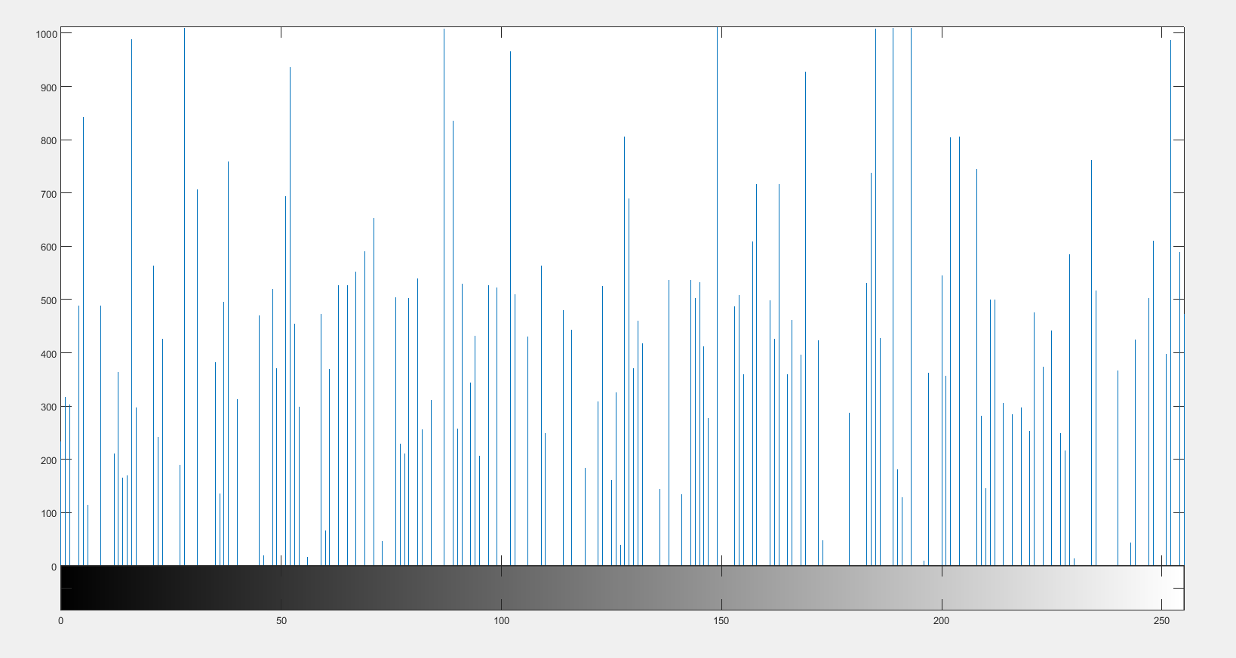
Results of ECC Encryption for Lena Image
Fig 1.a Input Image (Lena)
Fig 1.b Histogram of Input Image
Fig 1.c encrypted image(ECC)
Fig 1.d Histogram of encrypted image

Slide 11
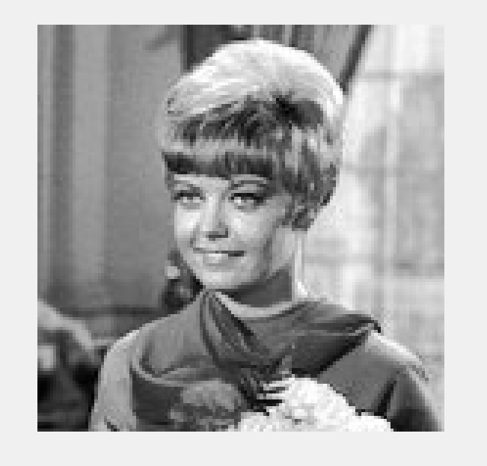
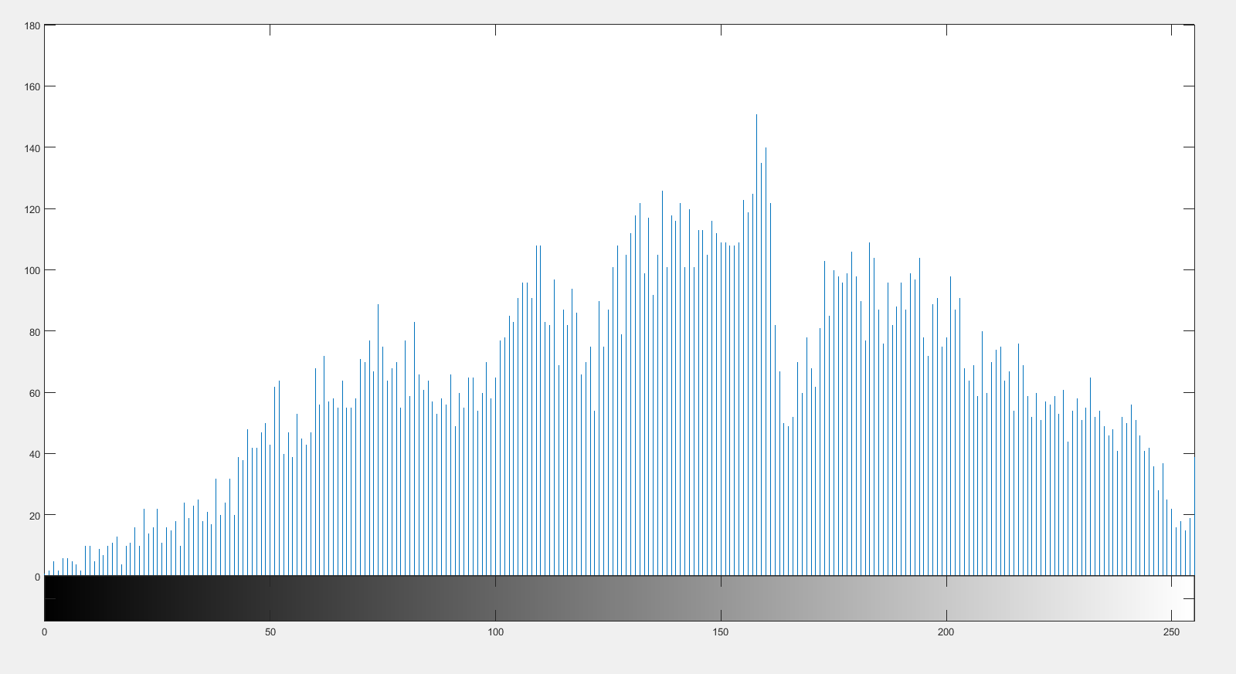
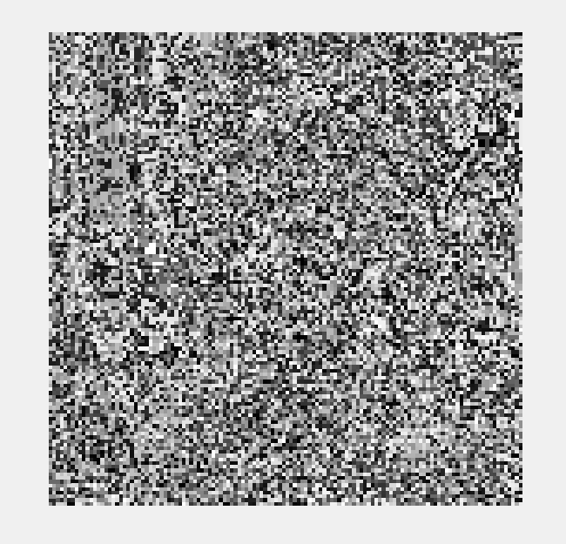
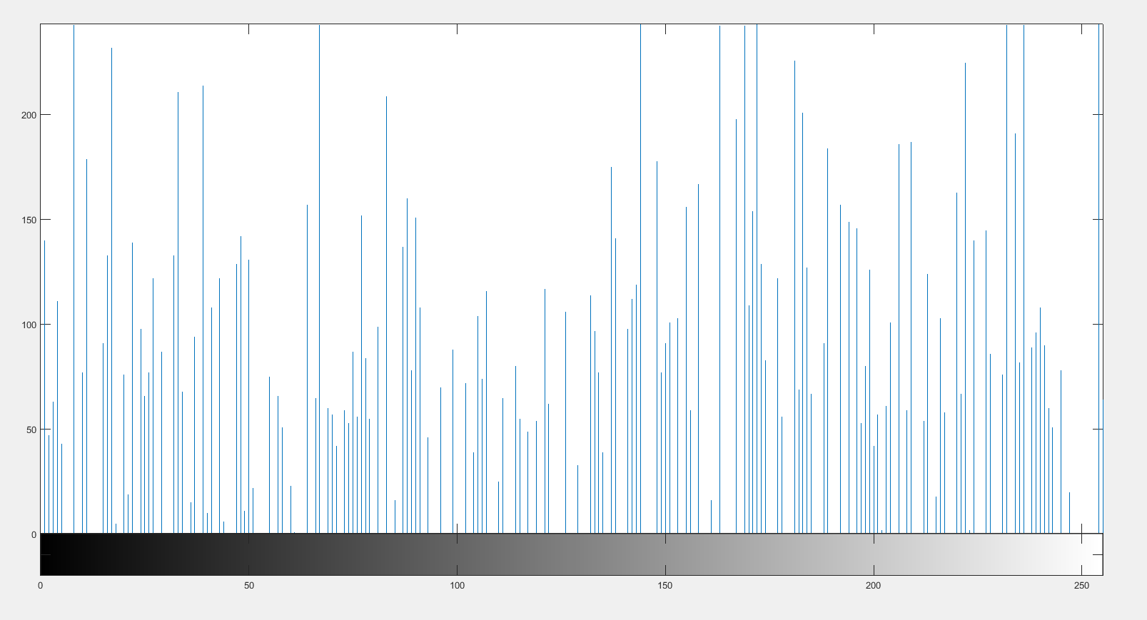
Results of ECC Encryption for Other Image
Fig 2.a Input Image
Fig 2.b Histogram of Input Image
Fig 2.c Encrypted Image
Fig 2.d Histogram of Encrypted image

Slide 12
Magic Matrix
A magic square is “magic” because it contains the property that the square consists of the distinct positive integers 1, 2, …,N ² (N>=3) such that the sum of the N numbers in any horizontal, vertical or main diagonal line is always the same magic constant.
For an NxN magic matrix, the sum of the rows or columns or diagonals can be given by N(N²+1)/2.
Magic matrix is used as a scrambling technique which scrambles the pixels of the image by position transformation.

Slide 13
Example of magic matrix
In the 3x3 matrix shown below, the values are arranged such that the sum of values in all the rows, columns and the diagonals is 15.
DIAG-1 SUM = 15
4 | 9 | 2
3 | 5 | 7
8 | 1 | 6
ROW SUM = 15
ROW SUM = 15
ROW SUM = 15
DIAG-2 SUM = 15
COL SUM = 15
COL SUM = 15
COL SUM = 15
Fig 3. 3x3 magic matrix

Slide 14
Construction of Magic Matrix
1. The first step is to place the number 1 in any of the cells of the N x N magic square. (A ‘1’ in the top middle will give a perfect magic square, however 1 can be placed anywhere, but, the diagonals might not sum to the magic number.)
2. The next step is to place the next successive integer in the square above and to the right of the “1”. This step is continued until the square is filled.
3. The numbers wrap around the square, so when the top of the square is reached, wrap to the bottom row, and if right side is r eached, then wrap to the left.
4. When the upper right corner is reached drop down one row to continue filling numbers.
5. When going to place the next number, x, in a cell that is already filled, then x is placed in the cell below x-1, the number that was just placed.

Slide 15
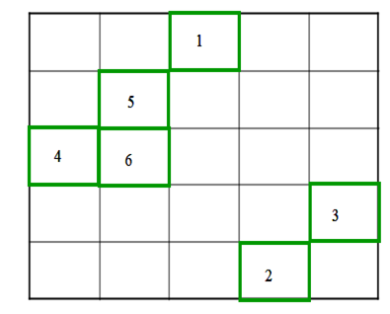
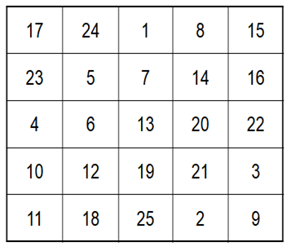

Construction of Magic Matrix
Fig 4. Magic matrix construction

Slide 16
Scrambling using magic matrix
The image matrix holding the pixel values in converted into a one-dimension matrix.
The pixel values are hence arranged linearly with indices from 1 to N².
The magic matrix is traversed, and each position is replaced by the pixel value that is contained in the index value that the position holds in the 1D matrix.
The obtained 2 dimensional matrix is sent as an input to AES.

Slide 17
Modifications
The technique of magic matrix has been modified by changing the pixel values after arranging them into a linear array before mapping with the magic matrix values.
Hence the modified technique is a combination of both value transformation and position transformation.
A 128 bit (16 byte) key is used to transform the values of the matrix.
This 16 byte key is XORed byte wise with each consecutive 16 byte chunk of the linearly arranged values while also checking the overflow condition.
This transforms the value of each pixel in the matrix which is already scrambled by using the magic matrix.

Slide 18
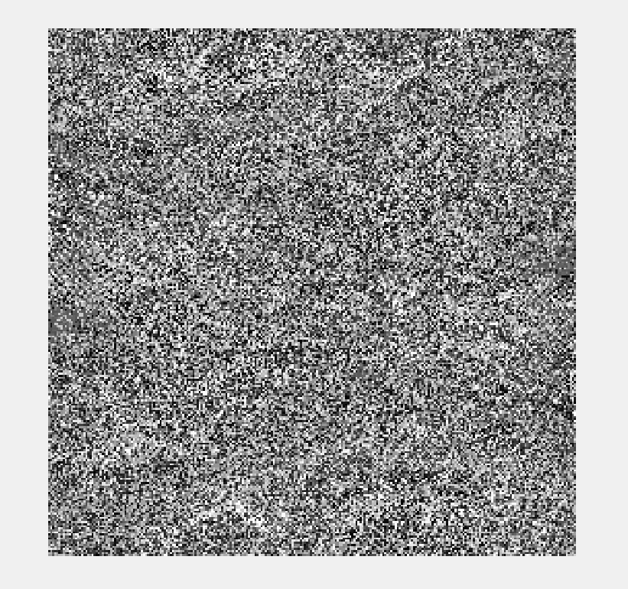
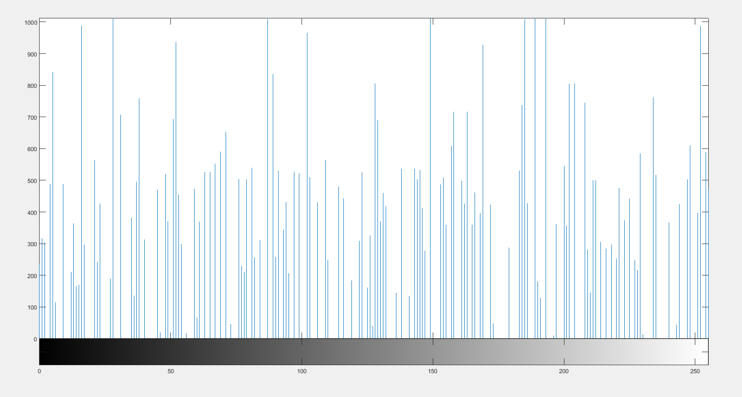
Results of Magic matrix Encryption for Lena Image
Fig 5a. Output image from ECC Block
Fig 5b. Histogram of ECC output image
Fig 5c. Encrypted image from magic matrix
Fig 5d. Histogram of encrypted image

Slide 19
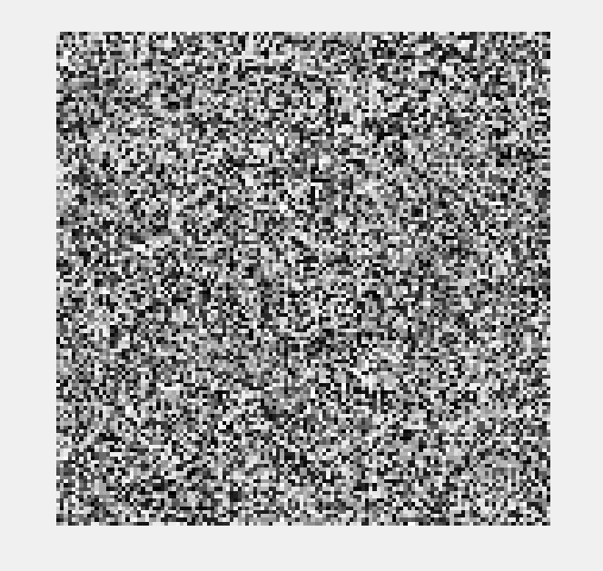

Results of Magic matrix Encryption for Other Image
Fig 6a. Output image from ECC Block
Fig 6b. Histogram of ECC output image
Fig 6c. Encrypted image from magic matrix
Fig 6d. Histogram of encrypted image

Slide 20
Advanced Encryption Standard (AES)
It uses higher length key sizes such as 128, 192 and 256 bits for encryption. Hence it makes AES algorithm more robust against hacking.
For 128 bit, about 2^128 attempts are needed to break. This makes it very difficult to hack it as a result it is very safe protocol.
AES repeats 4 major functions to encrypt data. It takes 128-bit block of data and a key and gives a ciphertext as output. The functions are:
Sub Bytes, Shift Rows, Mix Columns, Add Round Key
The number of rounds performed by the algorithm strictly depends on the size of key.
Table 1. AES parameters
Algorithm | Key length Nk | Block size Nb | No. of Rounds Nr
AES-128 | 4 | 4 | 10
AES-192 | 6 | 4 | 12
AES-256 | 8 | 4 | 14

Slide 21
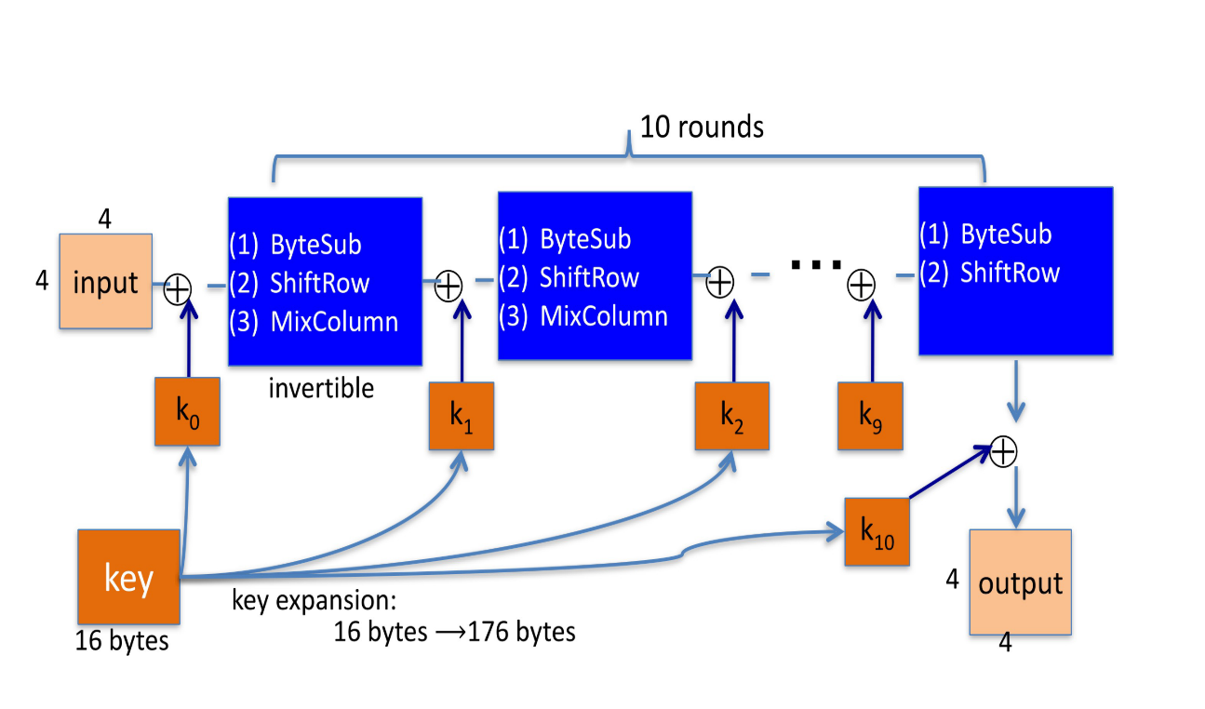
Fig 7. AES Encryption

Slide 22
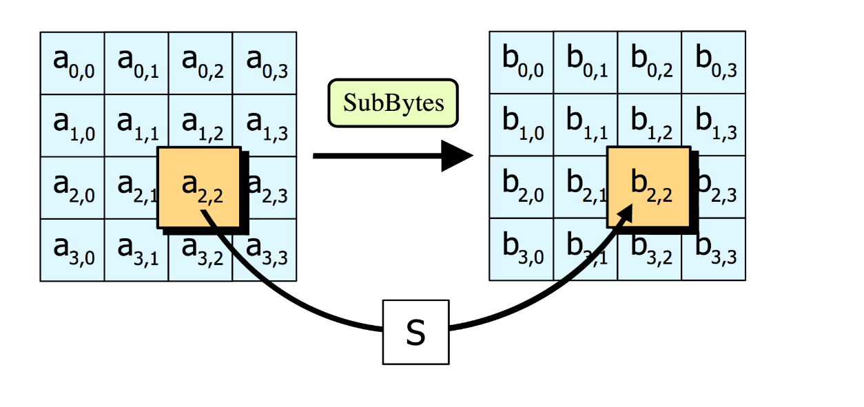
Step 1: Sub Bytes
Sub Bytes- Each element of the matrix is replaced by the an element of s-box matrix.
Fig 8. Sub bytes

Slide 23
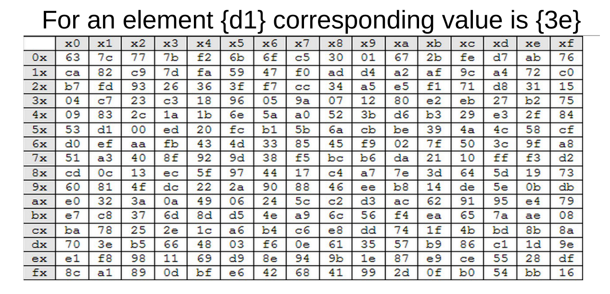
Fig 9. S-Box

Slide 24
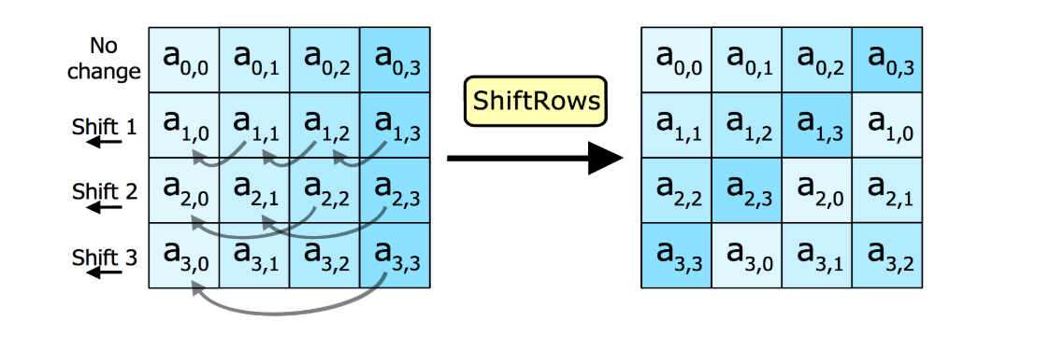
Step 2: Shift rows
In this step rows of the block are cylindrically shifted in left direction.
The first row is untouched , the second by one shift, third by two and fourth by 3.
Fig 10. Shift rows

Slide 25
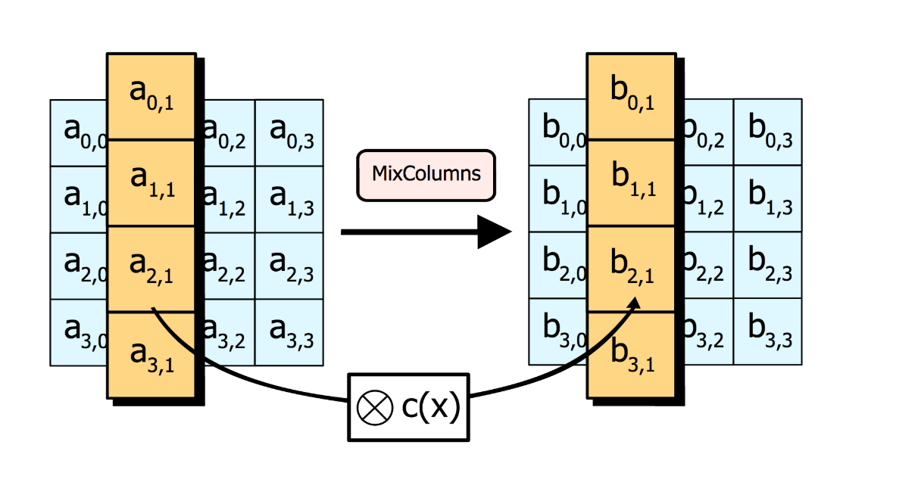
Step 3: Mix Columns
It causes the flip of bits to spread all over the block
In this step the block is multiplied with a fixed matrix.
The multiplication is field multiplication in Galois field.
For each row there are 16 multiplication, 12 XORs and a 4-byte output.
Fig 11. Mix columns

Slide 26
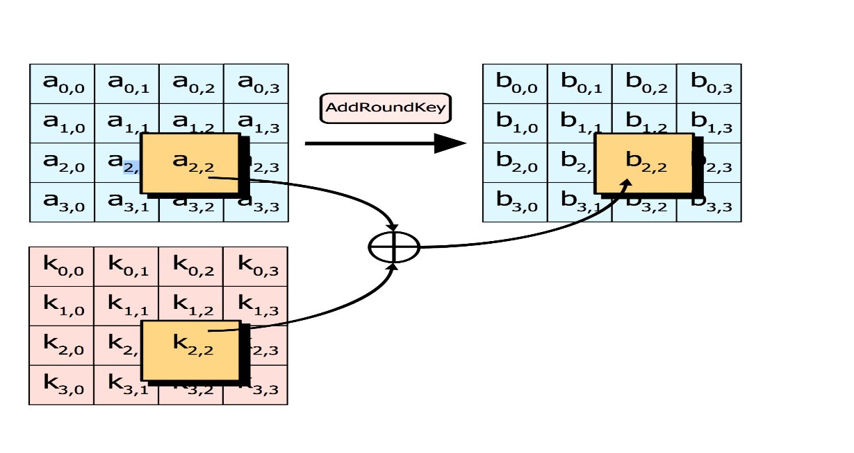
Step 4: Add round key
In this step each byte is XOR-ed with corresponding element of key's matrix.
Once this step is done the keys are no longer available for this step. Using the same key will weaken the algorithm.
To overcome this problem keys are expanded.
Fig 12. Adding round key

Slide 27
Modifications
AES was modified to take any size image input and break it into chunks of 16-byte blocks.
Key Generation algorithm was introduced which generates the key from the input image, the algorithm was to take every 16th byte from the input image as key until the size of the key becomes 128 bit. In case if the image size doesn't satisfy, then a random key was used for encryption.

Slide 28
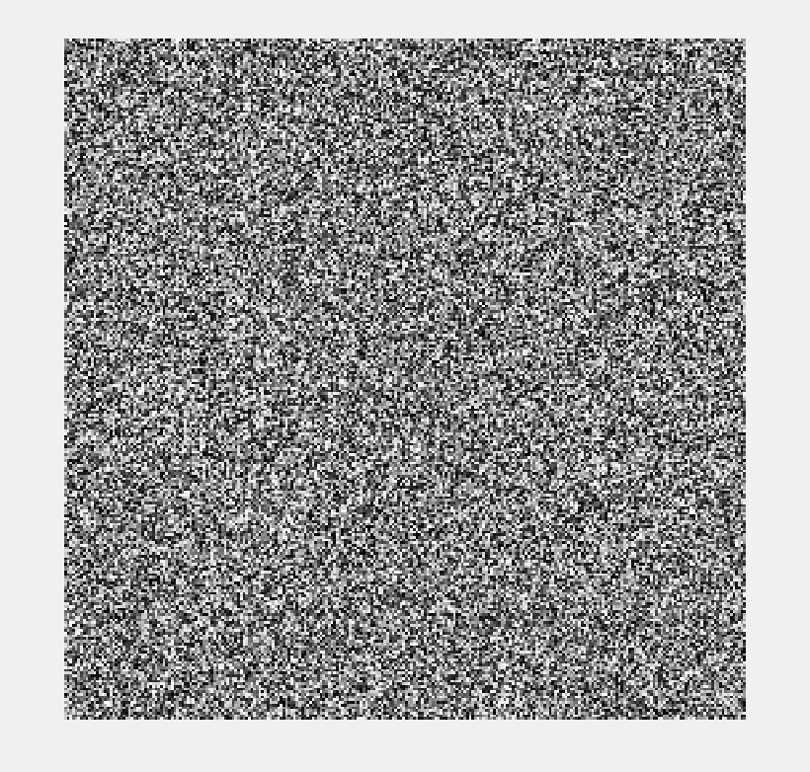
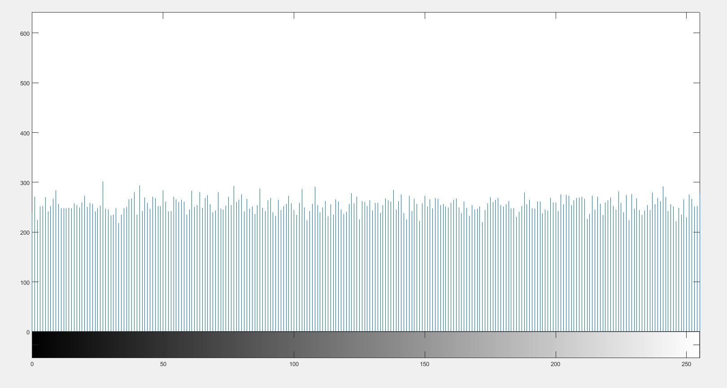
Final Encrypted output: Lena Image
Fig 13a. Input image (lena)
Fig 13b. Histogram of input image (lena)
Fig 13c. Final encrypted image (lena)
Fig 13d. Histogram of final encrypted input image (lena)

Slide 29
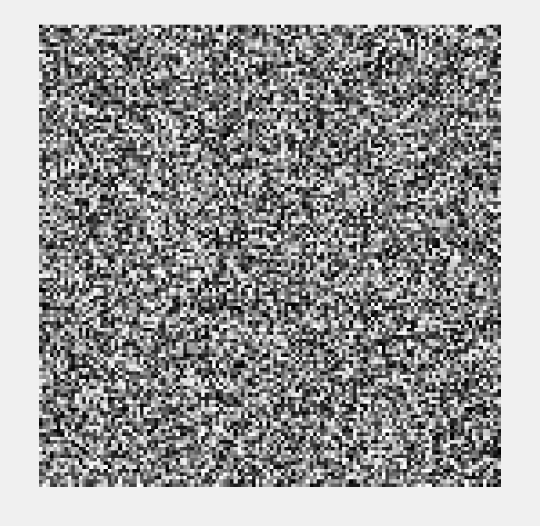
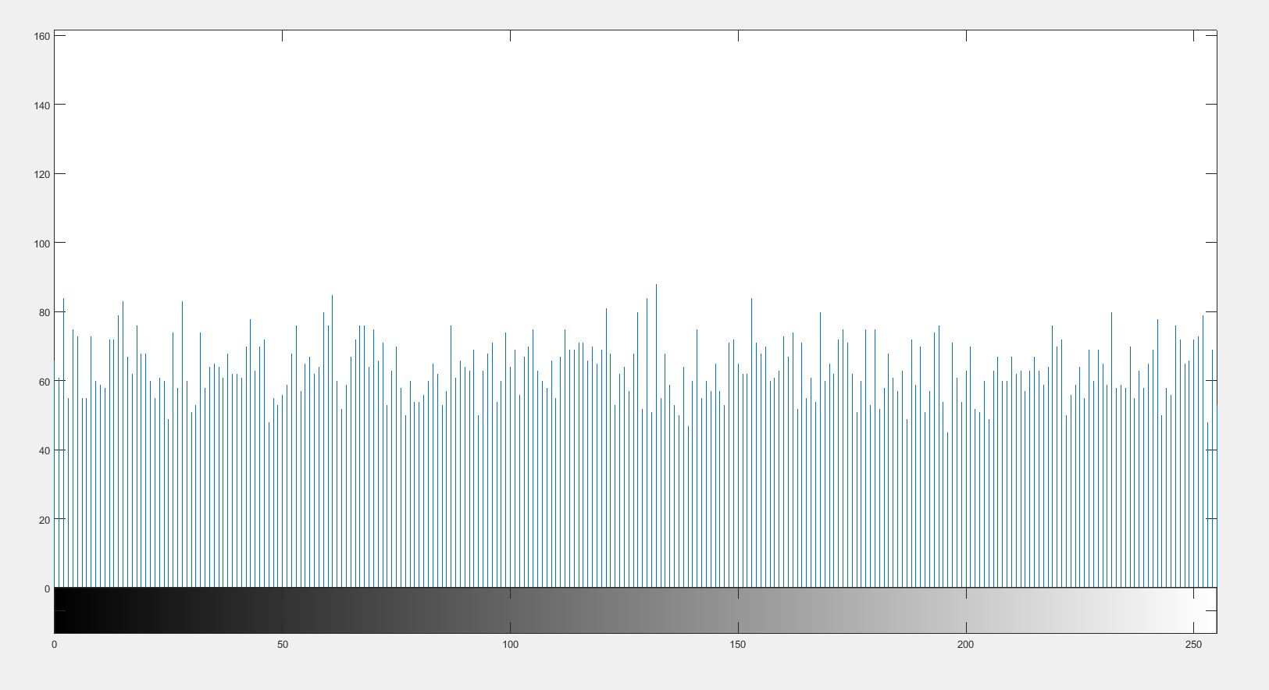
Final Encrypted output Other Image
Fig 14a. Input image
Fig 14b. Histogram of input image
Fig 14c. Final encrypted image
Fig 14d. Histogram of final encrypted image

Slide 30
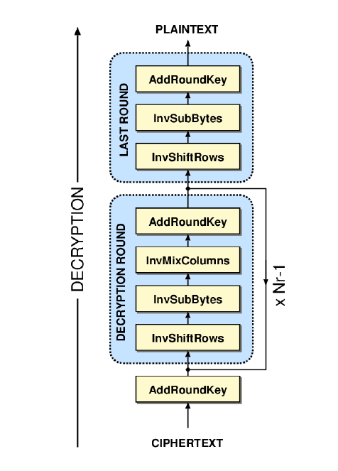
Decryption of Advanced Encryption Standard (AES)
The AES decryption basically
traverses the encryption algorithm
in the opposite direction.
AES decrypto initially performs
key expansion on the key block
that created all intermediate keys.
These intermediate keys are
generated from the original key
during encryption for every round.
Fig 15.

Slide 31
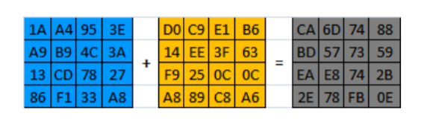
Steps involved in AES Decryption
Step 1: Inverse add round key
Performs XOR operation between the cipher text and intermediate expanded key corresponding to that particular iteration.
Step 2: Inverse mix column
The Inverse MixColumns operation performed by the Rijndael cipher, along with the shift-rows step, is the primary source of all the 10 rounds of diffusion in Rijndael.
Fig 16. Inverse add round key

Slide 32
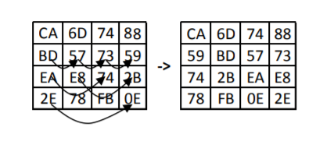
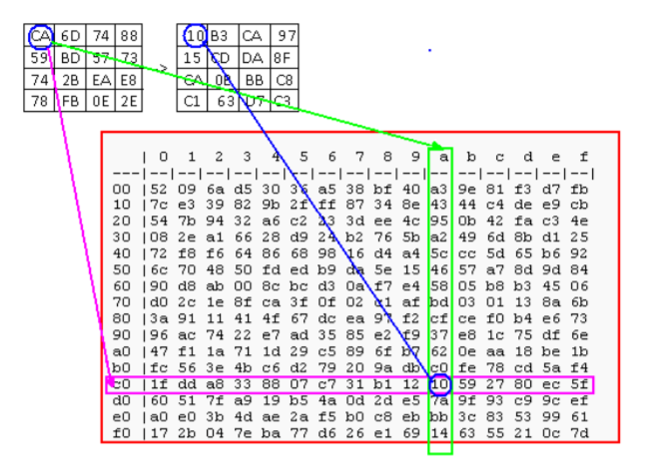
Step 3: Inverse shift row
This step rotates each ith row by i elements right wise, i=0,1,2,3
Step 4: Inverse sub bytes
This step replaces each entry in the matrix from the corresponding entry in the inverse S-Box.
Fig 17. Inverse shift row
Fig 18. Inverse sub bytes

Slide 33
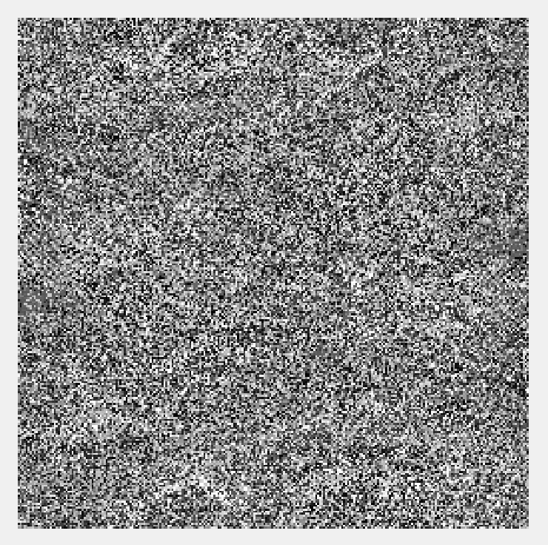
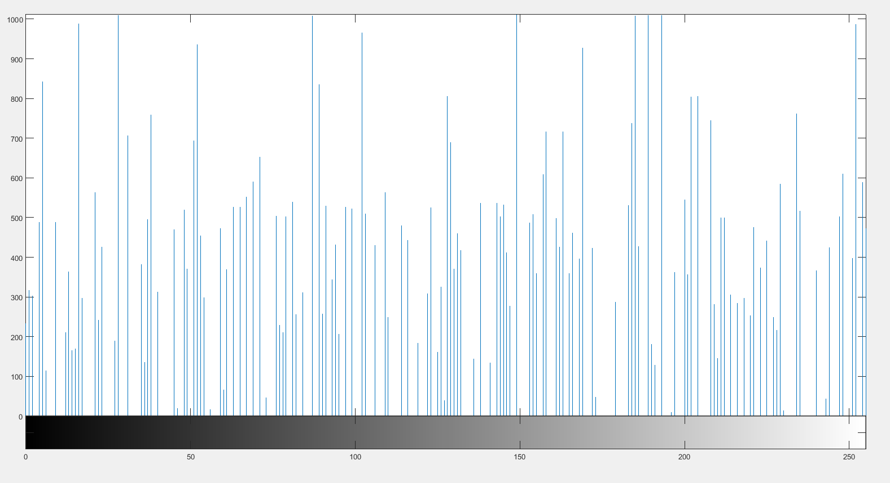
Results of AES Decryption for Lena Image
Fig 19.a Final encrypted
image
Fig 19.b Histogram of final encrypted Image
Fig 19.c Output from AES Decryption block
Fig 19.d Histogram of AES decrypted image

Slide 34
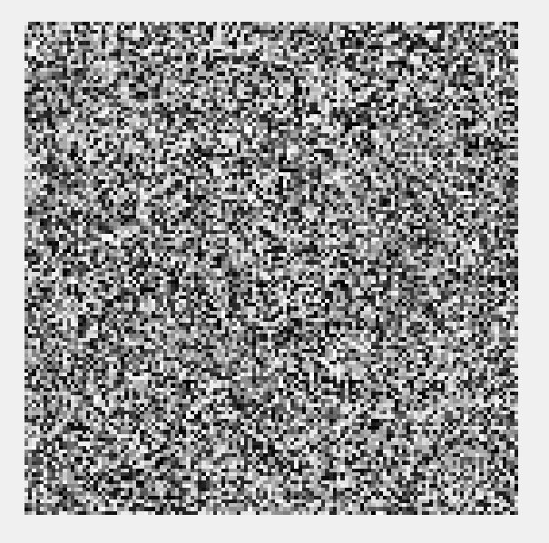

Results of AES Decryption for Other Image
Fig 20.a Final encrypted
image
Fig 20.b Histogram of final encrypted Image
Fig 20.c Output from AES Decryption block
Fig 20.d Histogram of AES decrypted image

Slide 35
Decryption of Magic Matrix
Create an empty one dimensional matrix which can accommodate all the pixel values and initialize the values with zeros.
Traverse the magic matrix and also the encrypted pixel matrix which is the output from the AES decryption..
With the value at the magic matrix position as index for the one dimensional matrix, fill the position of the one dimensional matrix with the value at the same position of the encrypted pixel matrix.
Hence a one dimensional matrix is obtained after descrambling using the magic matrix which is converted into two dimensional matrix.

Slide 36
Modifications
The 128 bit ( 16 byte) key which is used in the encryption of the image is used to decrypt the output obtained from AES decryption.
The 16 byte key is XORed byte wise with each consecutive 16 byte chunk of the one dimensional matrix obtained after descrambling the output from the AES decryption.
The obtained one dimensional matrix is converted into a two dimensional matrix.
This is sent as an input to the ECC decryption block.

Slide 37
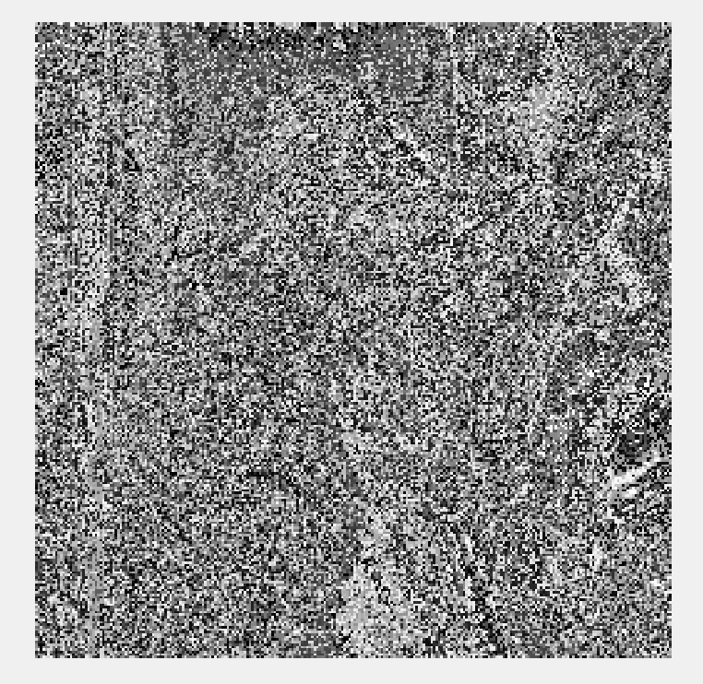
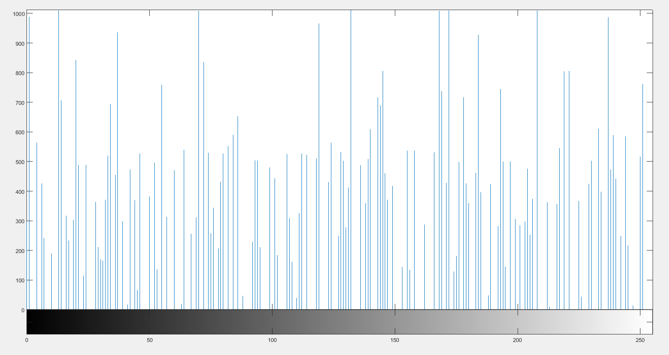
Results of Magic matrix Decryption for Lena Image
Fig 21.a Output from AES decrpt Block
Fig 21.b Histogram of AES decrypted Image
Fig 21.c Output from Magic matrix Decrypt block
Fig 21.d Histogram of magic matrix decrypted image

Slide 38
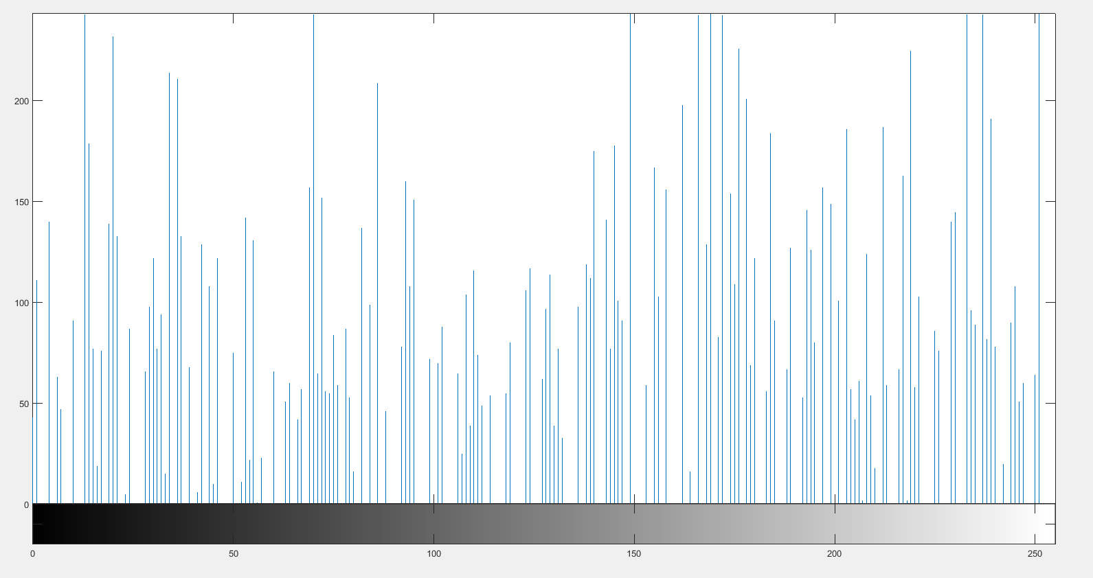
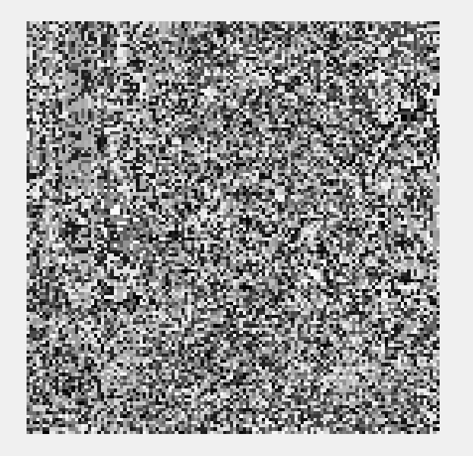
Results of Magic matrix Decryption for Other Image
Fig 22.a Output from AES decrpt Block
Fig 22.b Histogram of AES decrypted Image
Fig 22.c Output from Magic matrix Decrypt block
Fig 22.d Histogram of magic matrix decrypted image

Slide 39
Decryption of ECC block
The elements in the encrypted image matrix and the quotient matrix were used to recover the mapped pixel intensity value.
y(mapped) = q(quotient)*255 + e(encrypted matrix value)
The corresponding ‘x’ value was then found using the look-up table consisting of points on the elliptic curve.
The original pixel intensity value between 0 and 255 was solved for using the formula:
p(original) = floor [ (x - 1)/k],
where floor [ (x - 1)/k] represents the greatest integer less than (x-1)/k.

Slide 40

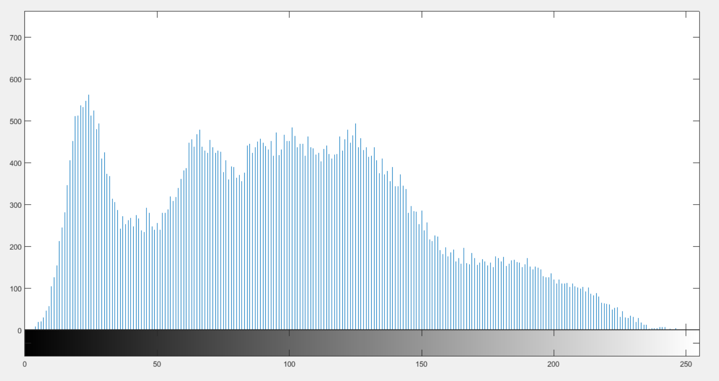
Final Decryption for Lena Image
Fig 23.a Output from Magic matrix decrpt Block
Fig 23.b Histogram of magic matrix decrypted Image
Fig 23.c Final Decrypted Image
Fig 23.d Histogram of final decrypted image

Slide 41
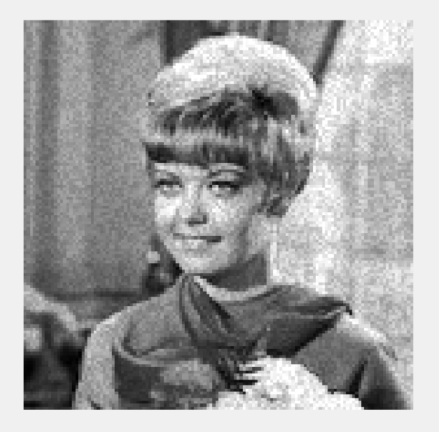
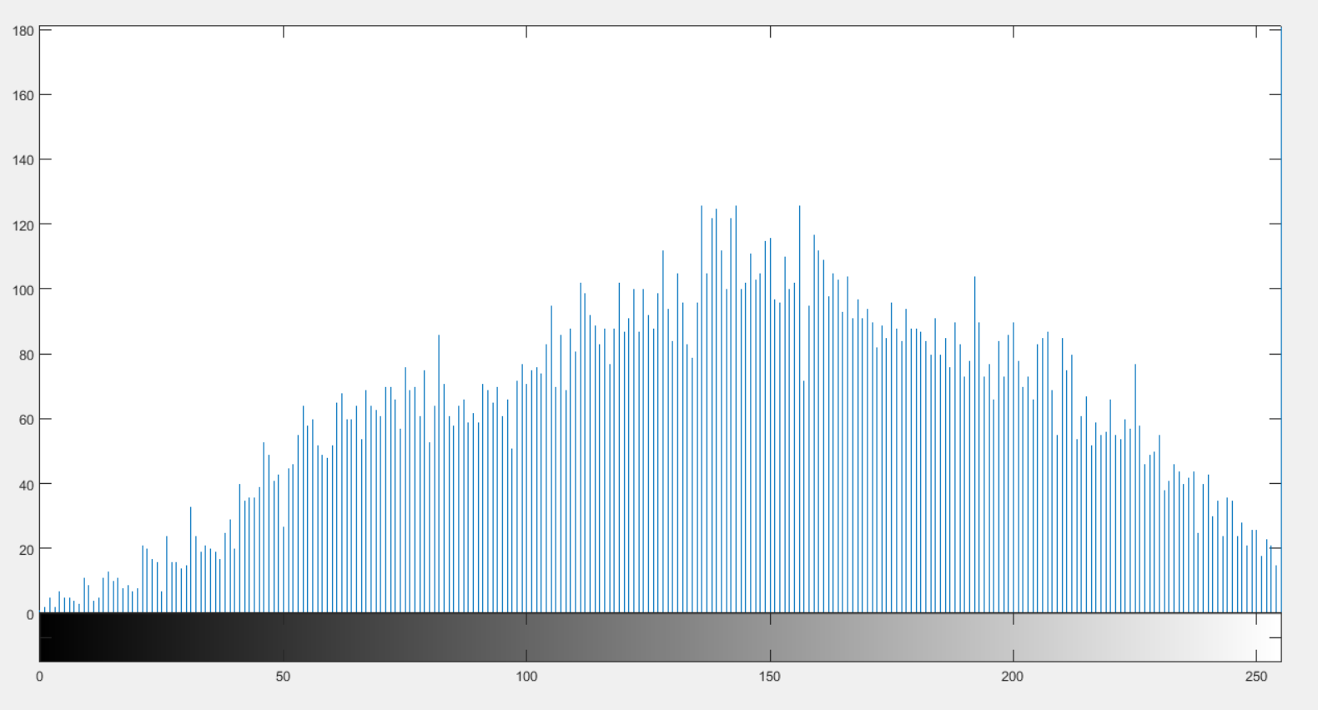
Final Decryption for Other Image
Fig 24.a Output from Magic matrix decrpt Block
Fig 24.b Histogram of magic matrix decrypted Image
Fig 24.c Final Decrypted Image
Fig 24.d Histogram of final decrypted image

Slide 42
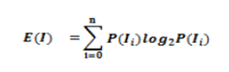
Results and Discussions
Parameters in consideration:
Number of changing pixel rate (NPCR) and Unified Averaged Changed Intensity(UACI): The NPCR measures the percentage of different pixels that change in two images which is the encrypted image when only one pixel is changed in the original image, while UACI measures the average intensity of differences between the original and encrypted images.
Entropy: Information entropy is a concept that tells how much information there is in an image. In general, the more uncertain or random the image is, the more information it will contain. It evaluate the scattering of pixel values in the image. For grayscale images entropy is theoretically equal to 8.

Slide 43
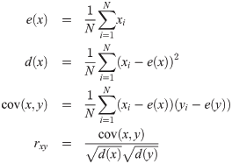
Correlation Coefficient: Correlation test consists of randomly selecting N pairs of adjacent pixels (vertical, horizontal, and diagonal) from the original and the encrypted images separately. Then, the correlation coefficient of each pair is calculated using
Key Sensibility: Encryption algorithms should also have high sensibility to encryption key. This means that any small change in the key should lead to a significant change in the encrypted, or decrypted, image.

Slide 44
Comparison of parameters:
Methods | Parameters
 | Correlation Coefficient |  | Entropy | Sensitivity Analysis
 | With Encrypted Image | With Decrypted Image |  | NPCR | UACI
Proposed Method (lena image) | -0.000758 | 0.9887 | 7.9975 | 0.9959 | 0.3068
Proposed method (Other image) | -0.00214 | 0.9786 | 7.9871 | 0.9958 | 0.3061
Enhanced logistic map^{[6]} | −0.0237 | 0.9658 | 7.996 | 0.9940 | 0.335
3D chaotic map^{[7]} | -0.0043 | 0.9496 | 7.989 | 0.9952 | 0.335
Table 2. Parameter comparison

Slide 45
Future Work
Adding a robust and secure, key distribution technique.
Video Cryptography

Slide 46
References
[1] Padma Bh, D.Chandravathi, P.Prapoorna Roja, “Encoding And Decoding of a Message in the implementation of Elliptic Curve Cryptography using Koblitz’s Method” International Journal on Computer Science and Engineering, Vol. 02, No. 05, 2010, 1904-1907.
[2] F. Amounas, E.H. El Kinani,”Security Enhancement of Image Encryption Based on
Matrix Approach using Elliptic Curve”, International Journal of Engineering Inventions, e-ISSN: 2278-7461, p-ISSN: 2319-6491 Volume 3, Issue 11 (June 2014) PP: 8-16.
[3] Srinivasan Nagaraj, Dr.G.S.V.P.RAJU, K.Koteswara rao, “Image Encryption Using Elliptic Curve Cryptography and Matrix”, International Conference on Intelligent Computing, Communication & Convergence, (ICCC-2014), doi: 10.1016/j.procs.2015.04.182.
[4] Megha Kolhekar and Anita Jadhav ”implementation of elliptic curve cryptography on text and image”, International Journal of Enterprise Computing and Business Systems, ISSN (Online): 2230-8849, 2011, vol. 1, Issue 2.
[5] Laiphrakpam Dolendro Singh, Khumanthem Manglem Singh, “Image Encryption using Elliptic Curve Cryptography”, Eleventh International Multi-Conference on Information Processing-2015 (IMCIP-2015), doi: 10.1016/j.procs.2015.06.054

Slide 47
[6] Priya Ramasamy, Vidhyapriya Ranganathan, Seifedine Kadry, “An Image Encryption Scheme Based on Block Scrambling, Modified Zigzag Transformation and Key Generation Using Enhanced Logistic—Tent Map” 21, 656; doi:10.3390/e21070656.
[7] Md. Billal Hossain, Md.Toufikur Rahman, A B M Saadmaan Rahman, “A new approach of image encryption using 3D chaotic map to enhance security of multimedia component”, Conference: 2014 International Conference on Informatics, Electronics & Vision (ICIEV) DOI: 10.1109/ICIEV.2014.6850856.
[8] Samiksha Sharma, Vinay Chopra, “Analysis Of Aes Encryption With Ecc”, Proceedings of International Interdisciplinary Conference On Engineering Science & Management Held on 17th - 18th December 2016, in Goa, India.ISBN: 9788193137383.
[9] A. K. Mandal, C. Parakash, and A. Tiwari. "Performance evaluation of cryptographic algorithms: DES and AES."Electrical, Electronics and Computer Science (SCEECS), 2012 IEEE Students' Conference on. IEEE, pp 1-5.
[10] S. Sowmiya, I. Monica Tresa, A. Prabhu Chakkaravarthy, “Pixel based image encryption using magic square”, 2017 International Conference on Algorithms, Methodology, Models and Applications in Emerging Technologies (ICAMMAET), 10.1109/ICAMMAET.2017.8186634.
[11] D.I. George Amalarethinam, J. Sai geetha, "Enhancing Security Level for Public Key Cryptosystem Using MRGA", World Congress on Computing and Communication Technologies (WCCCT), pp. 98-102, 2014, ISBN 978-1-4799-2876-7.
[12] MATLAB 2015a and 2017a Summary and documentation.

Slide 48
Thank You

